Slide 1
Competitive Programming
17 Mar. 2023
Andrei Novikov

Slide 2
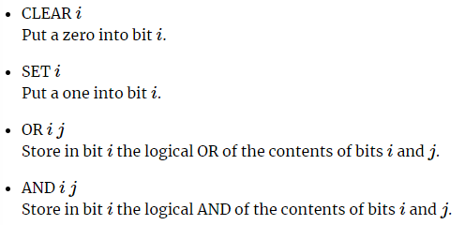
Home task Review
Tasks requires basic Boolean algebra knowledge: Link on Kattis.
Solution: Link on GitHub
AND
OR
Complexity: O(N)
x1 | x2 | r
0 | ? | 0
1 | ? | ?
? | 0 | 0
? | 1 | ?
x1 | x2 | r
0 | ? | ?
1 | ? | 1
? | 0 | ?
? | 1 | 1

Slide 3
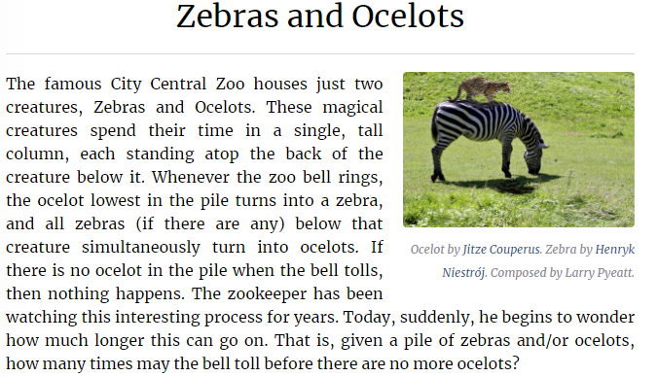
Practice #1
Task from 2017 ACM ICPC: Link on Kattis.

Slide 4
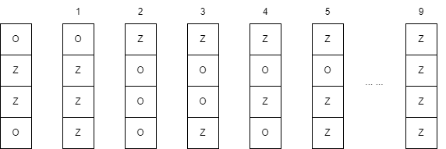
Practice #1 – Visualize the Process
Task from 2017 ACM ICPC: Link on Kattis.

Slide 5
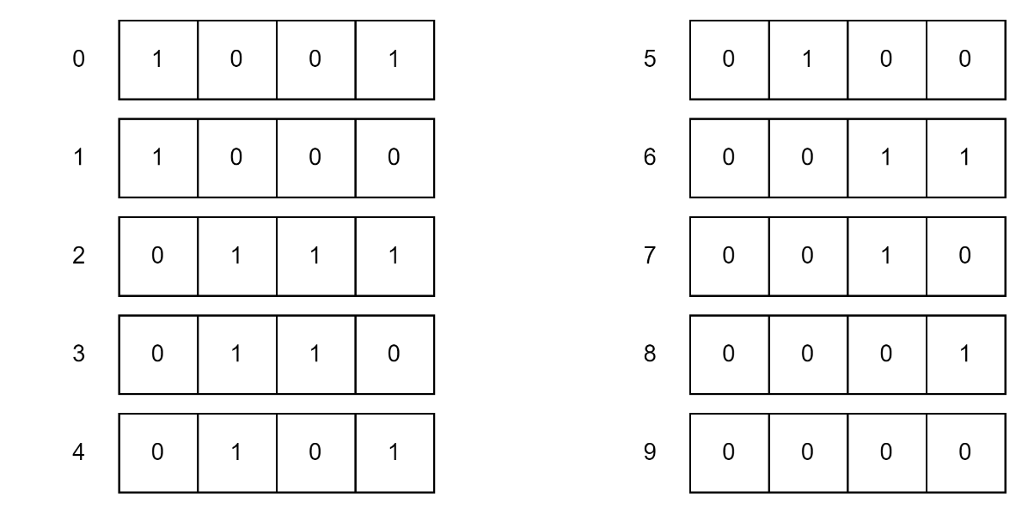
Practice #1 – Visualize the Process
Task from 2017 ACM ICPC: Link on Kattis.
0 – zebra
1 – ocelot
The answer is already in the input – consider it as a binary value

Slide 6
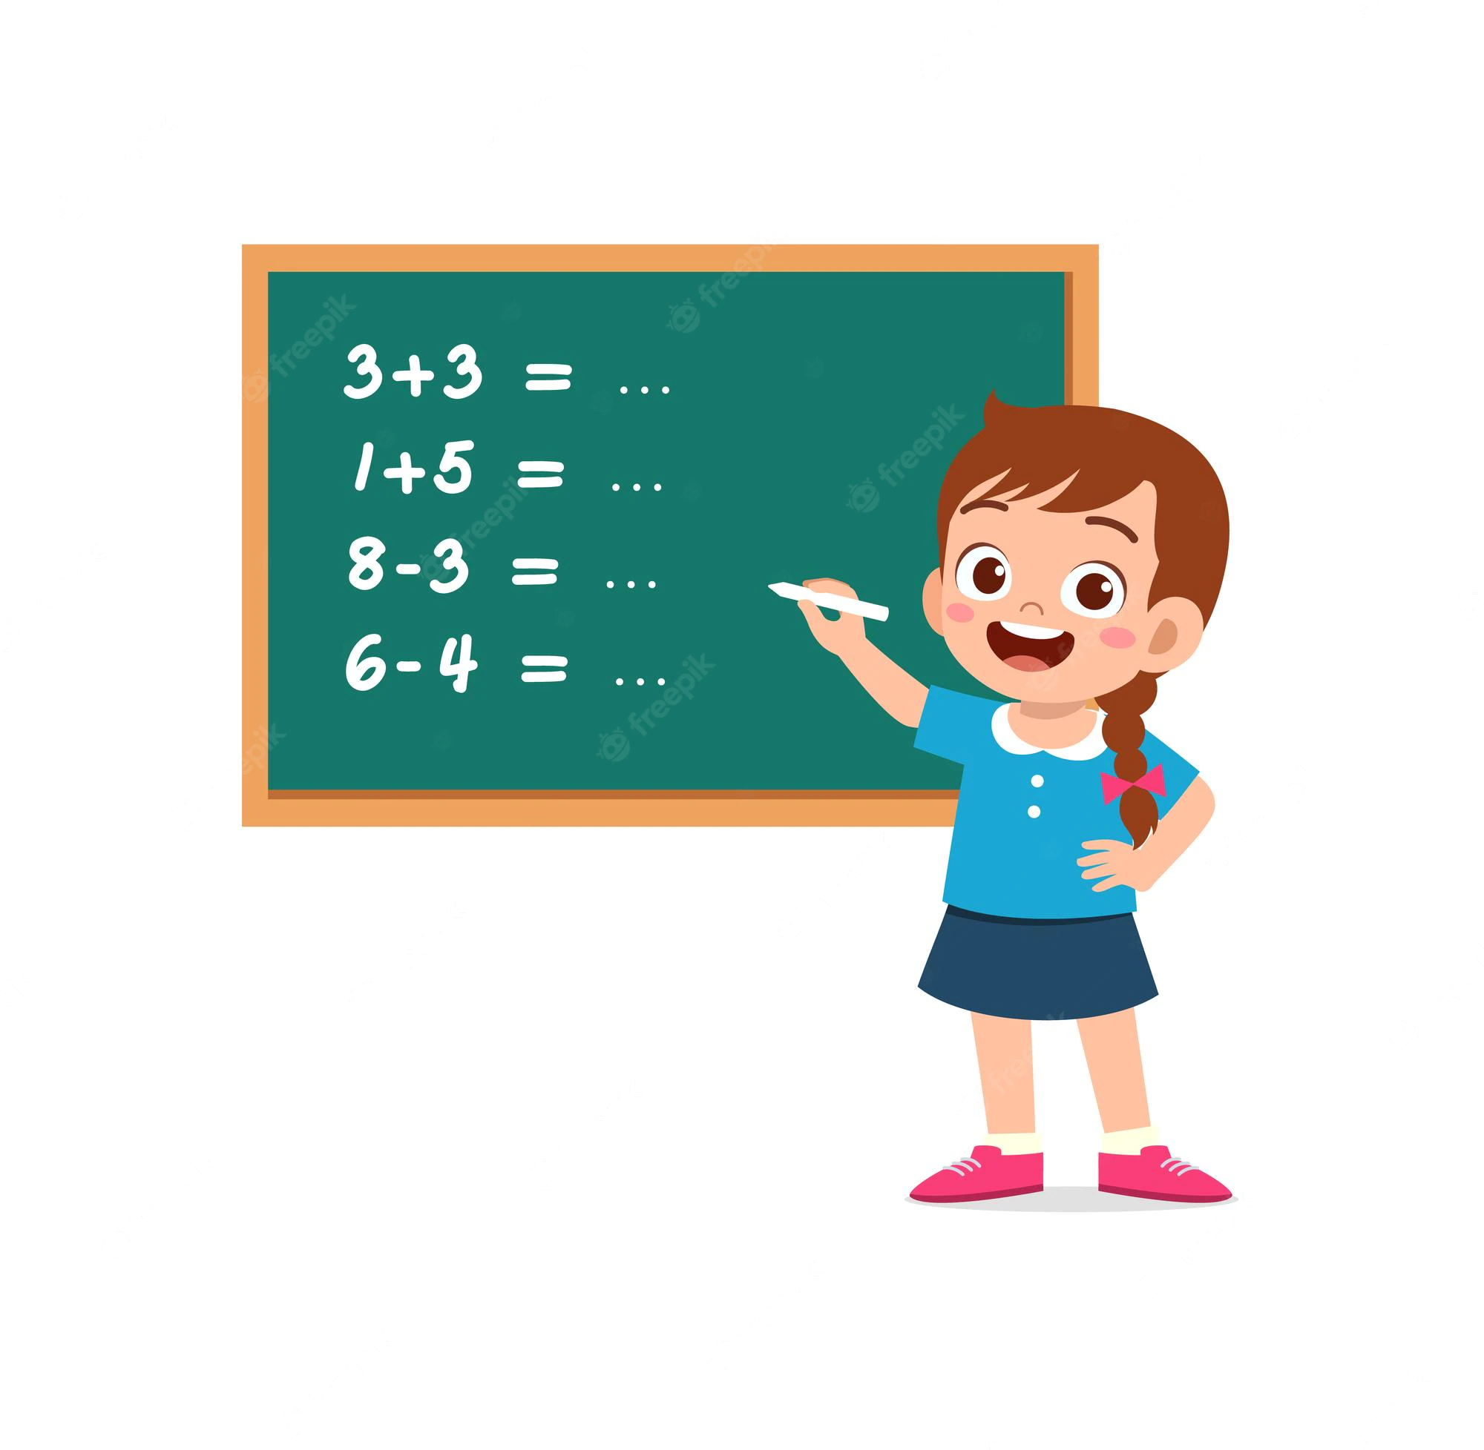
Practice #1 – Implement
Task from 2017 ACM ICPC: Link on Kattis.
0 – zebra
1 – ocelot

Slide 7
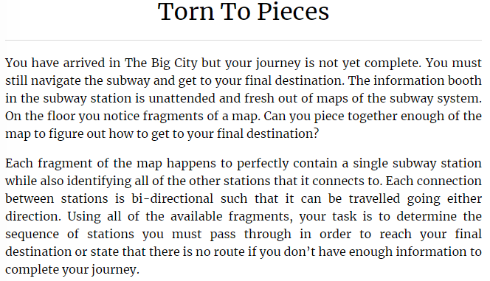
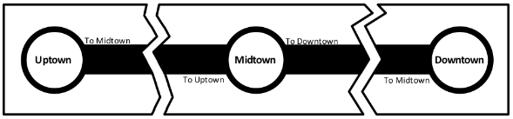
Practice #2
Task from 2015 ICPC North American Qualifier Contest: Link on Kattis.

Slide 8
Practice #2
Task from 2015 ICPC North American Qualifier Contest: Link on Kattis.
Typical BFS task where shortest path is should be found.
Dictionary to covert names to ids;
Dictionary to covert ids to names;
Classical BFS to find path;
Array to keep node parents to restore the path;

Slide 9
Practice #2
Task from 2015 ICPC North American Qualifier Contest: Link on Kattis.
Typical BFS task where shortest path is should be found.
Dictionary to covert names to ids;
Dictionary to covert ids to names;
Classical BFS to find path;
Array to keep node parents to restore the path;

Slide 10
Further Topics
Based on 2021 ICPC North America Regional Programming Contests (Link)
Markov chains, Markov processes;
There is no direct chapter, but it make sense to look into the following:
5.6 Probability Theory;
5.8 Game Theory;
Computational Geometry;
Chapter 7 (from Competitive Programming 3);

Slide 11
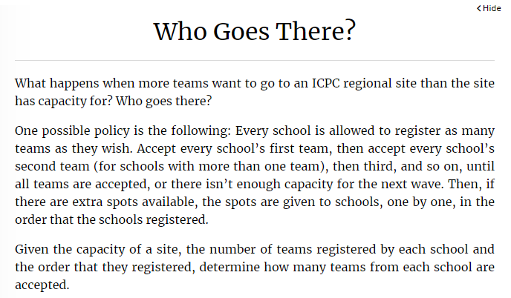
Homework?
Who Goes There – Link on Kattis
Hint: Simulate Process

Slide 12
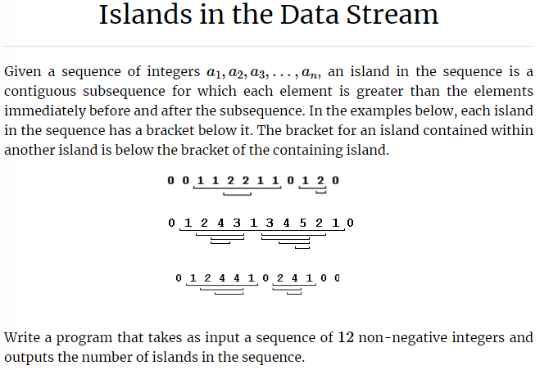
Homework?
Islands in the Data Stream – Link on Kattis

Slide 13




Where to Practice
LeetCode [link]
HackerRank [link]
Kattis [link]
TopCoder [link]
Other Resources

